Slide 1
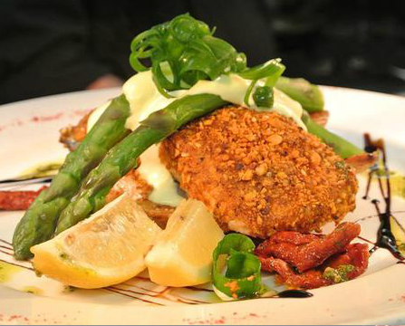
Sensational steaks
Served w chips, a gourmet salad or vegetables., and your choice of gravy.
5OOgm Premium New York short 35 tipped Rib Eye GF
400gm Grassland Sirloin GF 25
High Marble Count 400gm 28 Scotch Fillet GF
Black Angus 300 gm Rump 20
Aged American 450gm T-bone GF 26
Morocan Marinated Lamb Rump 23
Morocan spiced lamb rump cooked medium & served on roasted potatoes w sautéed greens,
red wine reduction, slow roasted tomato, basil
pesto and balsamic glaze.
Char grilled Chicken Breast 23
Grilled chicken breast stuffed w baby spinach & sundried tomatoes, then served on potato mash, sautéed greens , crumbed camembert, red wine reduction & red pepper pesto
Sauces & Sides
Gravy 3
Creamy Mushroom 3
Green peppercorn 3
Red wine glaze 3
Dianne 3
Garlic Prawn/Chilli prawns 6
Parmigiana 4
Hawaiian 4
Kilpatrick Sauce 4
Side Salad 4
Greek Salad 8
Small Chips 3
Large Chips 8
KIDS MEALS $8
Breast chicken nuggets, chips & salad
Ham and pineapple or pulled pork pizza sub with chips
Beer battered baby Barramundi, chips & salad
Penne Pasta Bolognaise
Grilled chicken salad
Salt n pepper squid w chips and salad
Mini cheeseburgers, tomato lettuce and sauce (2) with chips
8323 96OO
Open
Wednesday: Dinner
Thurs – Sun: Lunch/Dinner
Restaurant Bookings: (O8) 8323 8O38
Email: info@carmelsbarandgrill.com.au
www.carmelsbarandgrill.com.au
25O Main Road, McLaren Vale, 5171

Slide 2
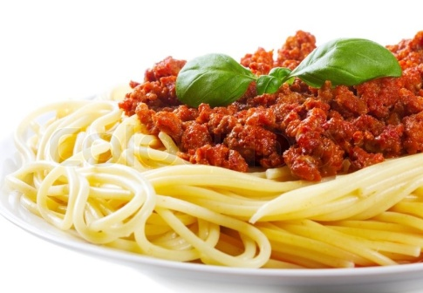
PASTA CHOICES: PENNE OR FETTUCCINI
Carbonara 15
Bacon, spring onions, cracked pepper, in a white cream sauce
Con Pollo 15 Marinated chicken, onion, sundried tomato baby spinach in a white wine creamy sauce
Bolognaise 15 Lean ground beef in a rich tomato sauce
Vegetarian 15 Roasted pumpkin, tomato, onion, mushrooms, olives & baby spinach in our tomato sugo v
Sully’s Chilli Prawns 19 Succulent chilli prawns w garlic, onion, sundried tomato, fresh herbs & spinach in our tomato sugo. Choice of ‘Mild’, ‘Medium’ or ‘Hot’
Garlic Loaf 4
Crumbed Camembert w Smashed Berries 6
Tomato, Avocado & Feta Bruschetta 10
Smoked salmon, Caper, Spanish Onion & Cream Cheese Bruschetta 10
House Dips 12
A selection of fresh house made dips
served w toasted Turkish bread
Fresh SA Oysters ½ Doz 13 / Doz 24
Natural w fresh lemon
Kilpatrick
- Bacon Jam
Thai
Smoked Salmon & Aioli
Salt n Pepper chilli
Crumbed with Garlic Aioli Combination (by doz only)
Wok Tossed Chilli Squid 12
Salt N Pepper Pork Ribs 15
Carmel’s Tapas Selection 21
Salt n pepper squid, crumbed camembert, char grilled chicken tenders, Cajun prawns & grilled chorizo w home made onion relish
Slow Roasted “Pulled Pork” 2O
Smoked over red gum for hours, served w an apple & mixed nut slaw, cheese and spring onion potatoes & a fluffy buttered roll
Dave’s American Pork Ribs 26
A rack of juicy pork ribs twice cooked until sticky in our signature BBQ sauce served w mixed nut & apple slaw & chips
Sage & Onion Crumbed Schnitzel 16
Your choice of Chicken Breast or Beef Porterhouse served w steakhouse chips & gourmet salad
Crispy Spanish Chicken & Avocado Salad 16
Succulent golden chicken tenderloins served on a gourmet salad of avocado, roasted pumpkin, Spanish onion, cucumber, tomato & fetta, w a light mango glaze (Gluten Free Available)
Add steak house chips 3 Prawn and Avocado Salad 24
Succulent Australia Prawns, pan seared in fresh ginger & sweet chilli, then deglazed with fresh lemon, served on a gourmet salad of avocado, mixed greens, sundried tomato, Spanish onion & roasted pumpkin. Add steak house chips 3
(Gluten Free Available)
Salt & Pepper Squid Salad 18
Tender Australian squid coated in chef’s own seasoning served w a gourmet salad, chips & house made aioli
Dukkah Crusted Atlantic Salmon 23
Atlantic salmon fillet, coated in Dukkah then seared & oven baked. Served on golden potatoes w sundried tomatoes, topped w steamed asparagus & hollandaise sauce. Garnished w balsamic glaze & pesto oil (Gluten Free Available)
Fish n Chips 17
(Beer Battered, Crumbed or Grilled) served w a gourmet salad, chips & house made aioli
(Gluten Free Available)
SERVED W CHIPS, ONION RINGS, SWEET CHILLI HOLLANDAISE DIPPING SAUCE & CHEFS TOMATO RELISH
The Ultimate Carmel’s Burger 16
Gourmet BBQ glazed Wagyu patty, cheese, bacon, egg, salad, house made aioli & onion relish
Chicken & Avocado Burger 16 Lightly spiced chicken tenders, fresh avocado, cheese, salad & seeded mustard aioli
Pulled Pork Burger 16 Spiced slow smoked pulled pork, bacon, cheese, lettuce, apple slaw & fresh coriander
Lamb Burger 16 Tender garlic sliced Moroccan lamb, cheese, bacon, house made onion relish, salad, red pepper pesto & a mint, garlic & lemon aioli
Vegetarian Burger 16 House made patty w baby spinach, potato, mushroom, onion, sundried tomato & pumpkin, served w cheese, salad, onion relish, red pepper pesto & aioli
BURGERS AND PASTA

